Slide 1
Hiwi Meeting 6
Date: 06/06/2020

Slide 2
Workflow
Hyperparameter script : holds all common tunable hyperparameters
Feature Selection : holds all the methods of Feature Selection; Outputs are csv files with selected Features and Label
Models : Contains all classifier models and options to select Feature Selection Method for data
Main : Automates all scripts and lets user select which Model user wants to work with.
here package used as required and all scripts under common Project folder.

Slide 3
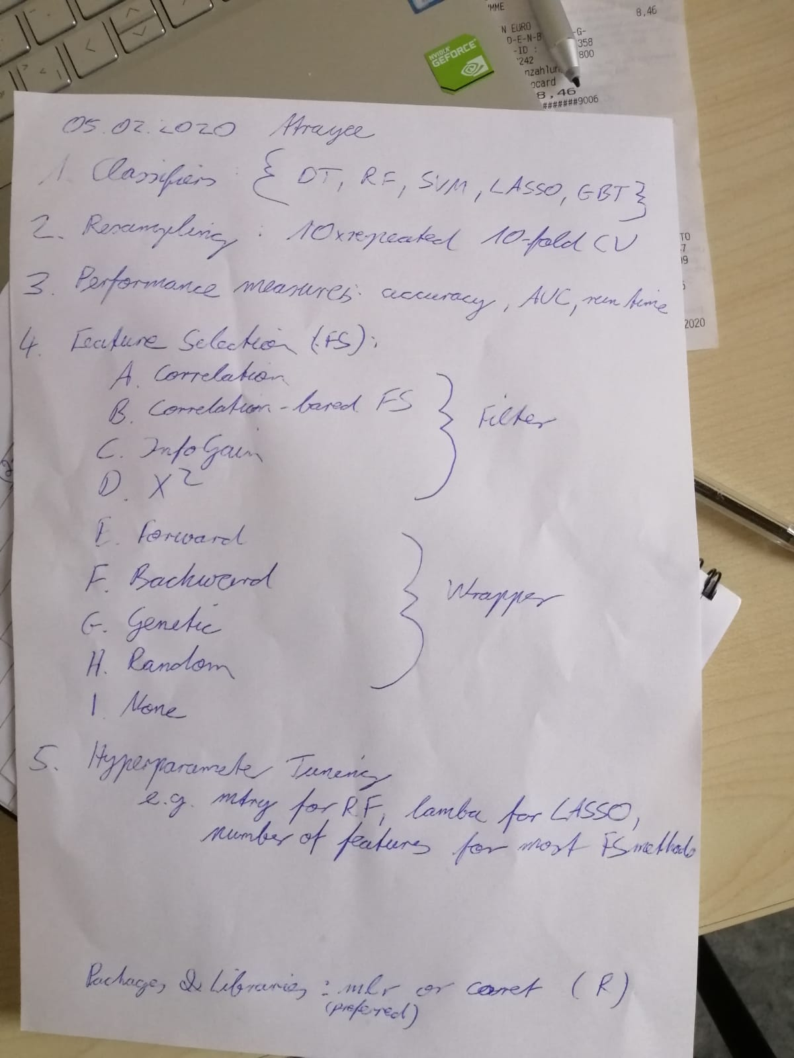
Tasks:

Slide 4
Total Counts:
95 Features after Correlation and removal of Near Zero variance
Type | Healthy | BAV | Total
Healthy v/s BAV | 90 | 22 | 112
Young v/s Old | Young: 53 Old: 37 | Young: 15 Old: 7 | Young: 68 Old: 44
Male v/s Female | Male: 45 Female: 45 | Male : 17 Female: 5 | Male: 62 Female: 50

Slide 5
Classifiers (pathology)
Correlation Based FS:
Model | Number of Features | Accuracy (Testing) | AUC | Kappa | Runtime (sec)
Decision Tree | 19 | 0.818 | 0.694 | 0.388 | 3.04
Random Forest | 19 | 0.939 | 0.833 | 0.765 | 4.68
SVM | 19 | 0.909 | 0.815 | 0.673 | 0.79
GBM | 19 | 0.939 | 0.898 | 0.796 | 2.67
Lasso | 19 | 0.939 | 0.898 | 0.796 | 3.09

Slide 6
Chi-Squared based FS
Model | Number of Features | Accuracy (Testing) | AUC | Kappa | Runtime (sec)
Decision Tree | 31 | 0.909 | 0.814 | 0.673 | 0.33
Random Forest | 94 | 0.969 | 1.000 | 0.891 | 0.23
SVM | 66 | 0.909 | 0.969 | 0.713 | 0.24
GBM | 10 | 0.909 | 0.975 | 0.713 | 0.18
Lasso | 31 | 0.939 | 0.932 | 0.765 | 0.39

Slide 7
Information Gain
Model | Number of Features | Accuracy (Testing) | AUC | Kappa | Runtime (sec)
Decision Tree | 31 | 0.909 | 0.814 | 0.673 | 0.03
Random Forest | 94 | 0.969 | 0.962 | 0.891 | 0.19
SVM | 94 | 0.969 | 1.000 | 0.891 | 0.05
GBM | 84 | 0.969 | 0.962 | 0.891 | 0.02
Lasso | 31 | 0.939 | 0.950 | 0.765 | 0.03

Slide 8
Sequential Algorithm(Forward) based FS:
Model | Number of Features | Accuracy (Testing) | AUC | Kappa | Runtime (sec)
Decision Tree | 1 | 0.909 | 0.814 | 0.673 | 19.36
Random Forest | 3 | 0.939 | 0.925 | 0.765 | 77.35
SVM | 2 | 0.939 | 1.000 | 0.765 | 43.92
GBM | 3 | 0.969 | 0.987 | 0.891 | 43.77
Lasso | 4 | 0.909 | 0.815 | 0.673 | 0.03
maxVortexVolumeRel"
"diastolicMaxLeftRotationVolumeRel"
"diastolicMaxVortexVolumeTime" "maxMeancircumferentialVelocity" "systolicMaxMeanAxialVelocityTime"

Slide 9
Sequential Algorithm(Backward) based FS:
Model | Number of Features | Accuracy (Testing) | AUC | Kappa | Runtime (sec)
Decision Tree | 1 | 0.909 | 0.814 | 0.673 | 673.11
Random Forest | 77 | 0.969 | 0.972 | 0.891 | 1016.13
SVM | 91 | 0.969 | 1.000 | 0.891 | 1350.81
GBM | 91 | 0.969 | 0.950 | 0.891 | 192.2
Lasso | 195 | 0.909 | 0.975 | 0.620 | 744.38

Slide 10
Genetic Algorithm based FS:
Model | Number of Features | Accuracy (Testing) | AUC | Kappa | Runtime (sec)
Decision Tree | 50 | 0.909 | 0.814 | 0.673 | 10.1
Random Forest | 53 | 0.909 | 0.981 | 0.673 | 32.57
SVM | 46 | 0.939 | 0.993 | 0.819 | 14.66
GBM | 48 | 0.969 | 0.981 | 0.891 | 17.25
Lasso | 92 | 0.909 | 0.901 | 0.673 | 12.58

Slide 11
Random based FS:
Model | Number of Features | Accuracy (Testing) | AUC | Kappa | Runtime (sec)
Decision Tree | 52 | 0.909 | 0.814 | 0.673 | 2.47
Random Forest | 53 | 0.939 | 0.962 | 0.796 | 4.95
SVM | 43 | 0.969 | 0.987 | 0.891 | 2.68
GBM | 51 | 0.909 | 0.987 | 0.673 | 3.36
Lasso | 96 | 0.909 | 0.919 | 0.673 | 2.28

Slide 12
No FS Methods:
Model | Number of Features | Accuracy (Testing) | AUC | Kappa | Runtime (sec)
Decision Tree | 95 | 0.818 | 0.500 | 0.246 | 3.04
Random Forest | 95 | 0.969 | 0.981 | 0.891 | 0.34
SVM | 95 | 0.969 | 0.981 | 0.891 | 0.07
GBM | 95 | 0.939 | 1.000 | 0.765 | 0.39
Lasso | 95 | 0.909 | 0.750 | 0.620 | 0.03

Slide 13
Results:Optimal Combination
SVM | 4 | 0.969 | 1.00 | 0.904 | 0.01
SVM | 12 | 0.969 | 0.981 | 0.891 | 0.09
SVM | 13 | 0.939 | 0.981 | 0.796 | 0.01

Slide 14
Visualizations

Slide 15
Healthy v/s BAV

Slide 16
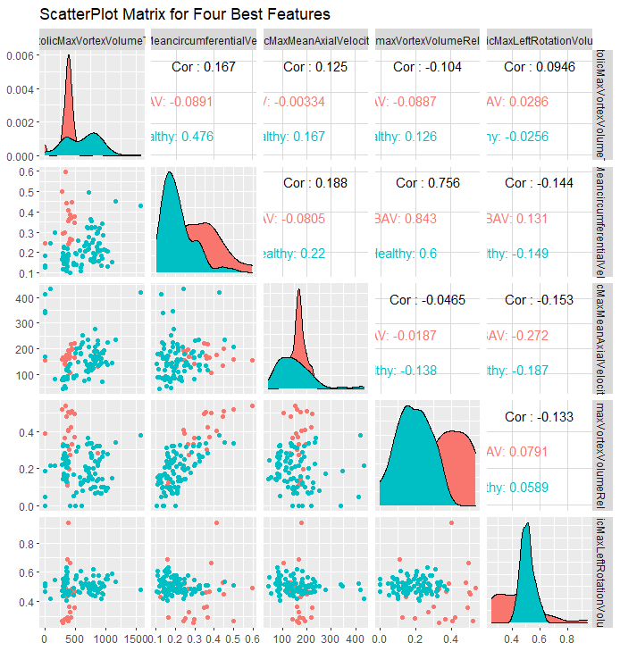
Healthy v/s BAV

Slide 17
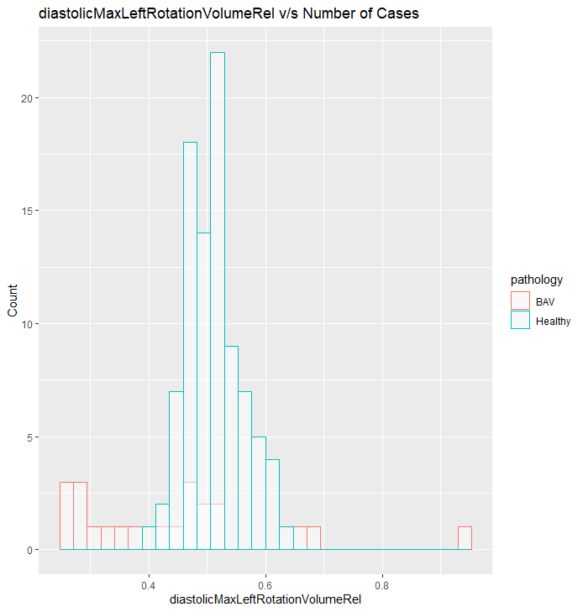
Healthy v/s BAV

Slide 18
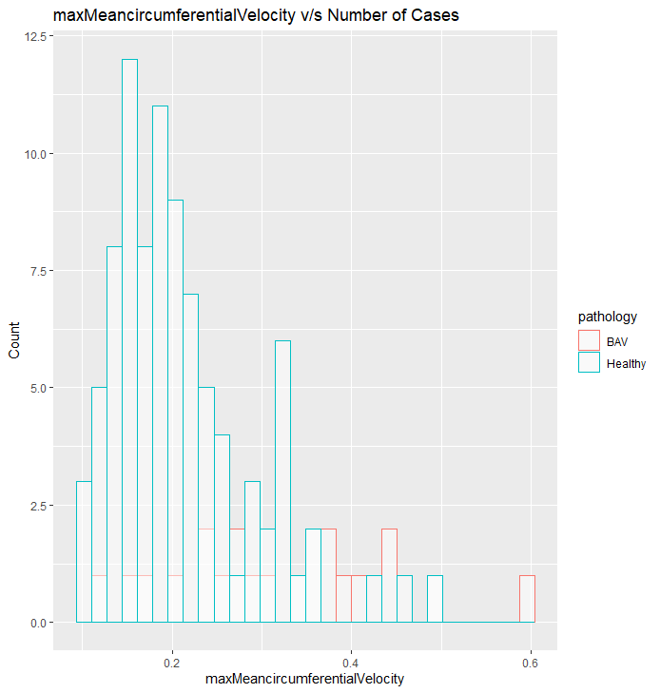
Healthy v/s BAV

Slide 19
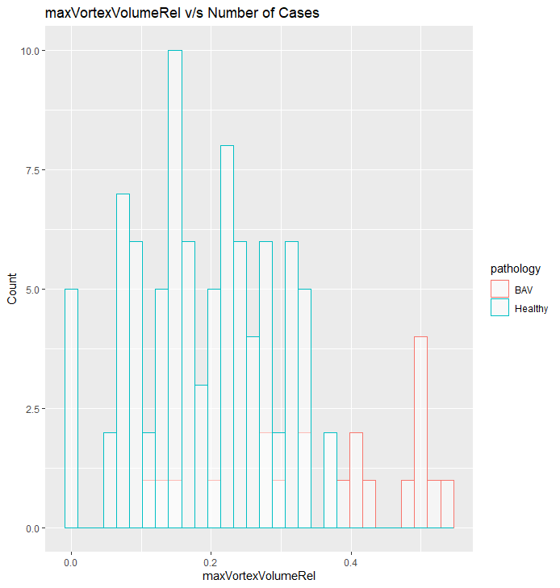
Healthy v/s BAV

Slide 20
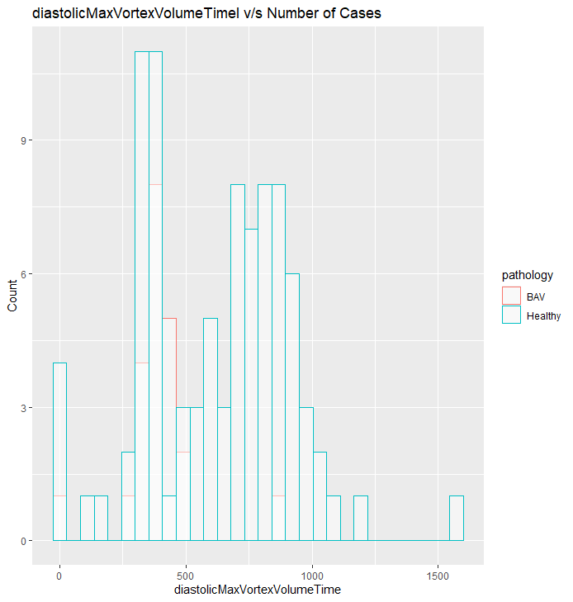
Healthy v/s BAV

Slide 21
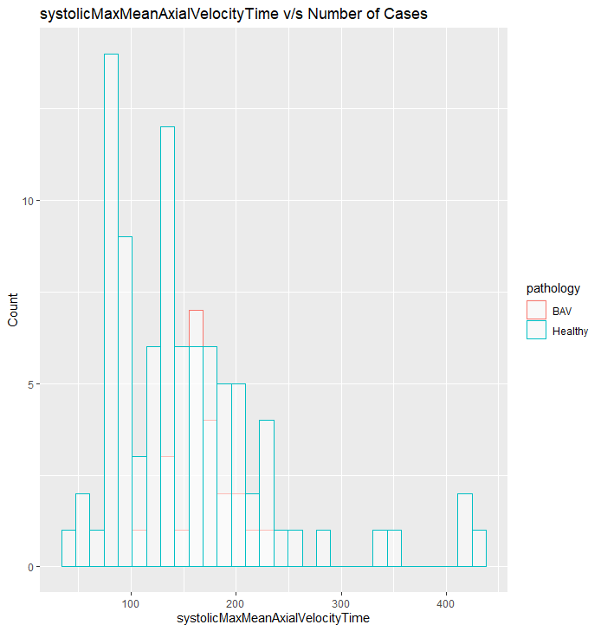
Healthy v/s BAV

Slide 22
Young v/s Old

Slide 23
Classifiers (age)
Correlation Based FS:
Model | Number of Features | Accuracy (Testing) | AUC | Kappa | Runtime (sec)
Decision Tree | 6 | 0.866 | 0.833 | 0.705 | 3.04
Random Forest | 5 | 0.866 | 0.861 | 0.722 | 1.62
SVM | 16 | 0.866 | 0.861 | 0.722 | 0.87
GBM | 12 | 0.730 | 0.801 | 0.461 | 0.50
Lasso | 7 | 0.800 | 0.778 | 0.571 | 1.61

Slide 24
Chi-Squared based FS
Model | Number of Features | Accuracy (Testing) | AUC | Kappa | Runtime (sec)
Decision Tree | 28 | 0.866 | 0.833 | 0.705 | 0.12
Random Forest | 85 | 0.933 | 1.000 | 0.864 | 0.41
SVM | 47 | 0.933 | 0.962 | 0.857 | 0.28
GBM | 47 | 0.933 | 0.990 | 0.864 | 0.16
Lasso | 28 | 0.933 | 0.981 | 0.864 | 0.17

Slide 25
Information Gain
Model | Number of Features | Accuracy (Testing) | AUC | Kappa | Runtime (sec)
Decision Tree | 28 | 0.866 | 0.833 | 0.705 | 0.02
Random Forest | 85 | 0.866 | 1.000 | 0.736 | 0.05
SVM | 47 | 0.933 | 0.962 | 0.857 | 0.05
GBM | 47 | 0.933 | 0.981 | 0.864 | 0.02
Lasso | 28 | 0.933 | 0.981 | 0.864 | 0.03

Slide 26
Sequential Algorithm(Forward) based FS:
Model | Number of Features | Accuracy (Testing) | AUC | Kappa | Runtime (sec)
Decision Tree | 1 | 0.866 | 0.833 | 0.705 | 3.04
Random Forest | 3 | 0.866 | 0.981 | 0.722 | 0.05
SVM | 2 | 0.933 | 1.000 | 0.857 | 23.86
GBM | 2 | 0.846 | 0.842 | 0.722 | 29.07
Lasso | 3 | 0.866 | 0.944 | 0.864 | 0.03
age
systolicMaxVortexVolume
maxCrossSectionalArea diastolicMedianVortexVolumeRel

Slide 27
Sequential Algorithm(Backward) based FS:
Model | Number of Features | Accuracy (Testing) | AUC | Kappa | Runtime (sec)
Decision Tree | 1 | 0.866 | 0.833 | 0.705 | 549.7
Random Forest | 32 | 0.933 | 1.000 | 0.933 | 1140.24
SVM | 8 | 0.866 | 0.814 | 0.722 | 927.56
GBM | 2 | 0.933 | 0.990 | 0.864 | 457.64
Lasso | 79 | 1.000 | 1.000 | 1.000 | 425.6

Slide 28
Genetic Algorithm based FS:
Model | Number of Features | Accuracy (Testing) | AUC | Kappa | Runtime (sec)
Decision Tree | 46 | 0.866 | 0.861 | 0.722 | 9.59
Random Forest | 36 | 0.866 | 1.000 | 0.736 | 0.05
SVM | 48 | 0.933 | 0.981 | 0.864 | 0.01
GBM | 37 | 0.733 | 0.946 | 0.500 | 0.04
Lasso | 40 | 0.866 | 0.796 | 0.722 | 10.58

Slide 29
Random based FS:
Model | Number of Features | Accuracy (Testing) | AUC | Kappa | Runtime (sec)
Decision Tree | 37 | 0.866 | 0.861 | 0.722 | 1.54
Random Forest | 50 | 0.933 | 1.000 | 0.864 | 0.01
SVM | 38 | 0.933 | 0.981 | 0.864 | 0.04
GBM | 46 | 0.902 | 0.864 | 0.731 | 0.04
Lasso | 41 | 0.933 | 0.944 | 0.857 | 1.62

Slide 30
No FS Methods:
Model | Number of Features | Accuracy (Testing) | AUC | Kappa | Runtime (sec)
Decision Tree | 85 | 0.800 | 0.777 | 0.571 | 3.04
Random Forest | 85 | 0.866 | 0.768 | 0.705 | 0.34
SVM | 85 | 0.733 | 0.925 | 0.444 | 0.07
GBM | 85 | 0.866 | 0.768 | 0.705 | 0.04
Lasso | 85 | 0.933 | 0.917 | 0.857 | 0.03

Slide 31
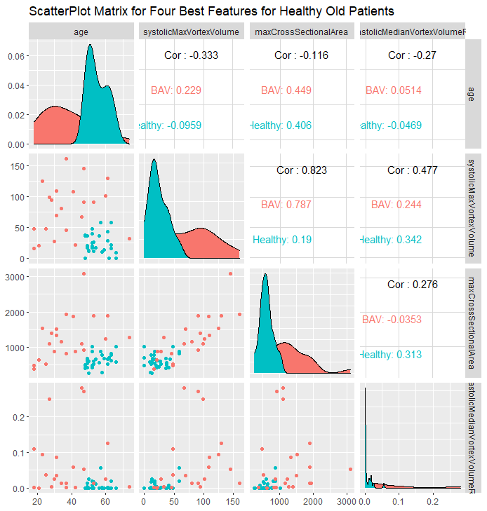
Young v/s Old (Threshold: 47) Scatter Plot Matrix

Slide 32
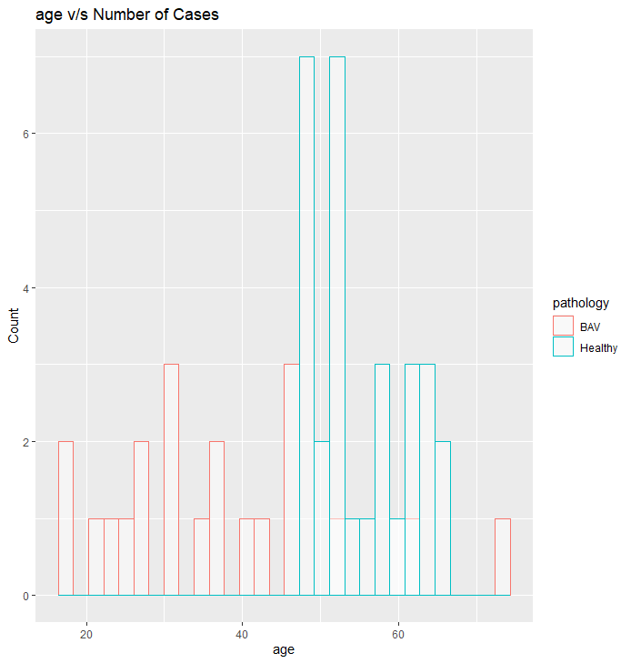
Young v/s Old (Threshold: 47)

Slide 33
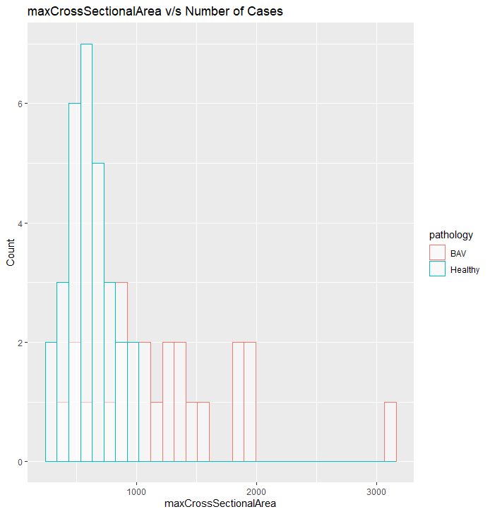
Young v/s Old (Threshold: 47)

Slide 34
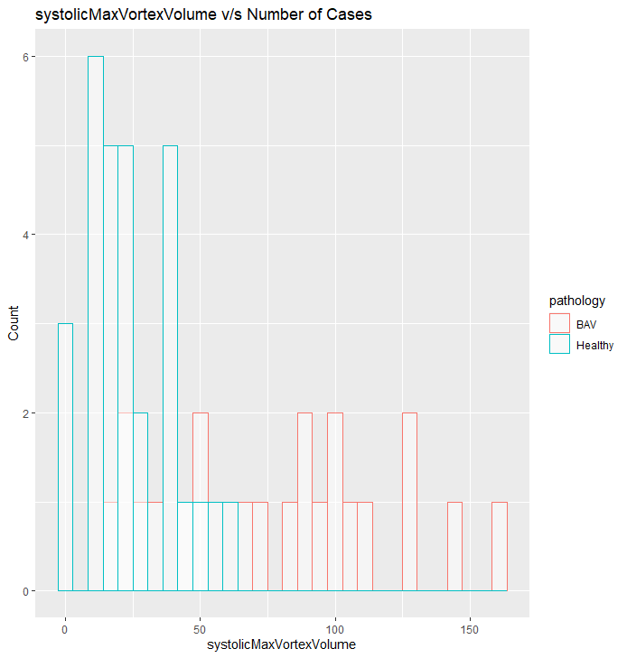
Young v/s Old (Threshold: 47)

Slide 35
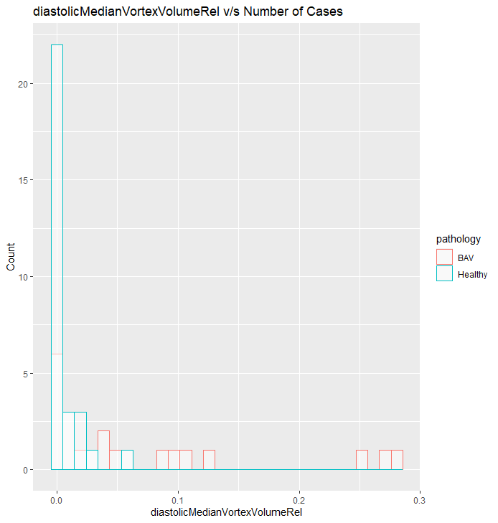
Young v/s Old (Threshold: 47)

Slide 36
Conclusions: Old Healthy Patients:
All misclassifications were Pathological patients being classified as Healthy.
Age ranges were from 23-74
Removing the Age feature also did not result in the misclassifications being too high.
According to the results, old Healthy patients do not have the same flow conditions as the Young Pathological ones, as Accuracy is pretty high.

Slide 37
Male v/s Female

Slide 38
Classifiers (gender)
Correlation Based FS:
Model | Number of Features | Accuracy (Testing) | AUC | Kappa | Runtime (sec)
Decision Tree | 3 | 0.500 | 0.500 | 0.000 | 3.04
Random Forest | 5 | 0.423 | 0.423 | -0.153 | 0.05
SVM | 10 | 0.423 | 0.423 | -0.153 | 0.01
GBM | 3 | 0.538 | 0.538 | 0.076 | 0.17
Lasso | 3 | 0.269 | 0.269 | -0.461 | 0.03
meanMeanAxialVelocity
diastolicMaxOverallVelocityQ99Time
minFlowJetHighVelocityAreaPercentVelocityWeighted

Slide 39
Chi-Squared based FS
Model | Number of Features | Accuracy (Testing) | AUC | Kappa | Runtime (sec)
Decision Tree | 35 | 0.846 | 0.846 | 0.692 | 0.25
Random Forest | 35 | 0.807 | 0.878 | 0.615 | 0.19
SVM | 12 | 0.576 | 0.573 | 0.153 | 0.04
GBM | 12 | 0.730 | 0.792 | 0.461 | 0.17
Lasso | 35 | 0.692 | 0.852 | 0.384 | 0.27

Slide 40
Information Gain
Model | Number of Features | Accuracy (Testing) | AUC | Kappa | Runtime (sec)
Decision Tree | 35 | 0.846 | 0.846 | 0.692 | 0.30
Random Forest | 35 | 0.807 | 0.878 | 0.615 | 0.05
SVM | 12 | 0.576 | 0.573 | 0.153 | 0.02
GBM | 82 | 0.423 | 0.325 | -0.153 | 0.02
Lasso | 35 | 0.692 | 0.852 | 0.384 | 0.03

Slide 41
Sequential Algorithm(Forward) based FS:
Model | Number of Features | Accuracy (Testing) | AUC | Kappa | Runtime (sec)
Decision Tree | 2 | 0.846 | 0.846 | 0.692 | 23.05
Random Forest | 3 | 0.692 | 0.893 | 0.384 | 85.42
SVM | 3 | 0.615 | 0.497 | 0.230 | 34.65
GBM | 3 | 0.615 | 0.727 | 0.230 | 35.54
Lasso | 4 | 0.692 | 0.852 | 0.384 | 0.03
"minDiameter"
"medianVortexVolumeRel" "diastolicMaxMeanPressureInVortexRegionTime"

Slide 42
Sequential Algorithm(Backward) based FS:
Model | Number of Features | Accuracy (Testing) | AUC | Kappa | Runtime (sec)
Decision Tree | 1 | 0.769 | 0.840 | 0.538 | 1063.19
Random Forest | 105 | 0.653 | 0.786 | 0.307 | 188.86
SVM | 97 | 0.538 | 0.508 | -0.076 | 185.8
GBM | 102 | 0.346 | 0.331 | -0.307 | 1084.53
Lasso | 85 | 0.730 | 0.816 | 0.461 | 0.01

Slide 43
Genetic Algorithm based FS:
Model | Number of Features | Accuracy (Testing) | AUC | Kappa | Runtime (sec)
Decision Tree | 54 | 0.769 | 0.840 | 0.538 | 8.25
Random Forest | 51 | 0.769 | 0.816 | 0.538 | 33.42
SVM | 54 | 0.423 | 0.420 | -0.153 | 8.71
GBM | 42 | 0.423 | 0.455 | -0.153 | 7.95
Lasso | 61 | 0.846 | 0.869 | 0.692 | 14.14

Slide 44
Random based FS:
Model | Number of Features | Accuracy (Testing) | AUC | Kappa | Runtime (sec)
Decision Tree | 48 | 0.769 | 0.840 | 0.538 | 1.68
Random Forest | 48 | 0.692 | 0.857 | 0.384 | 5.53
SVM | 53 | 0.538 | 0.591 | 0.076 | 1.53
GBM | 57 | 0.461 | 0.378 | -0.076 | 1.28
Lasso | 54 | 0.769 | 0.798 | 0.538 | 3.45

Slide 45
No FS Methods:
Model | Number of Features | Accuracy (Testing) | AUC | Kappa | Runtime (sec)
Decision Tree | 106 | 0.500 | 0.500 | 0.000 | 3.04
Random Forest | 106 | 0.384 | 0.426 | -0.230 | 0.34
SVM | 106 | 0.384 | 0.355 | -0.230 | 0.07
GBM | 106 | 0.500 | 0.562 | 0.000 | 0.04
Lasso | 106 | 0.615 | 0.615 | 0.230 | 0.03

Slide 46
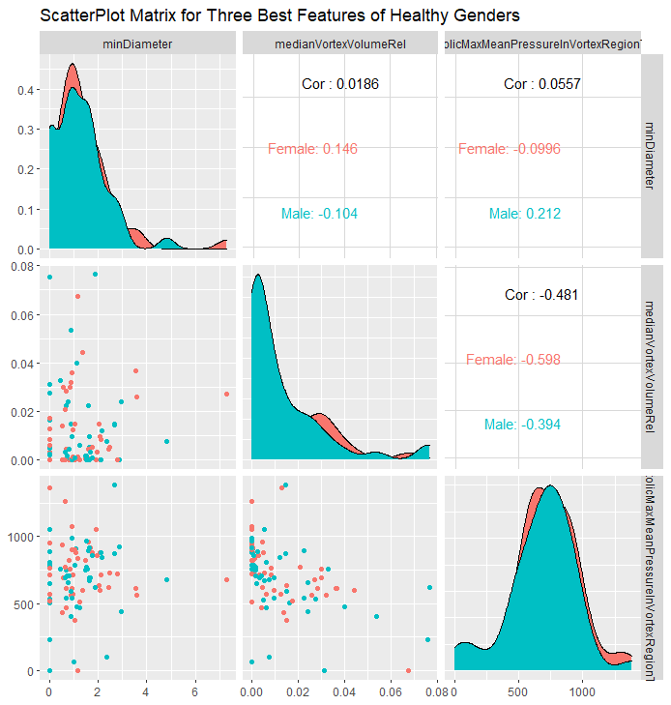
Male v/s Female Forward Selection

Slide 47
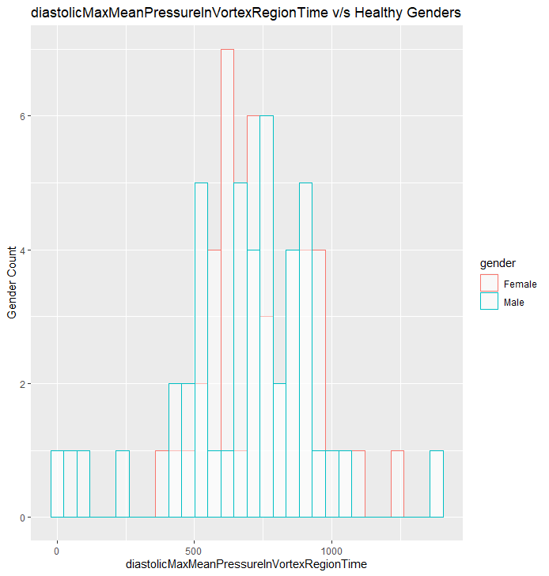
Male v/s Female Sequential Forward

Slide 48
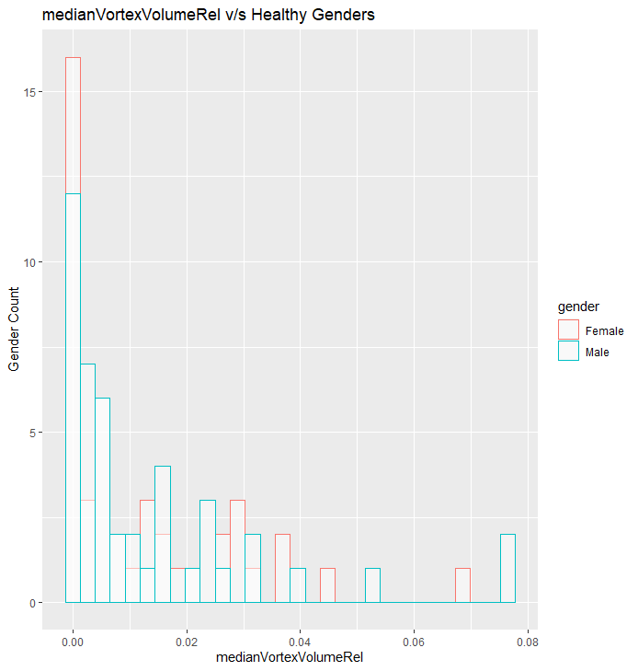
Male v/s Female Sequential Forward

Slide 49
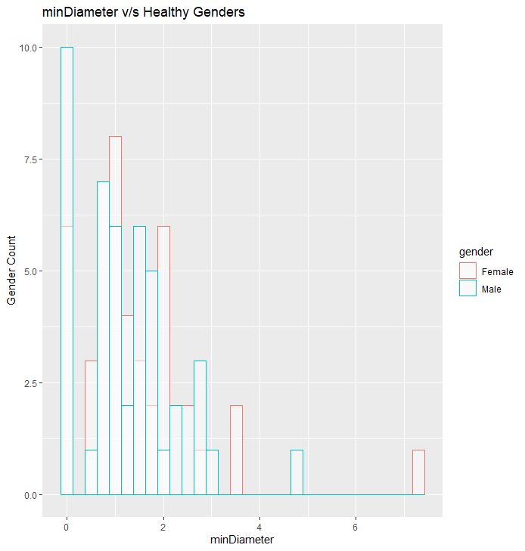
Male v/s Female Sequential Forward

Slide 50
Conclusions: Male v/s Female
The Accuracy of models is pretty low with low kappa values
The plots were for Features extracted from two different FS methods:
Sequential Forward (5)
Correlation (3)
The plots also confirm the Hypothesis that the dependence of a patient being Healthy or Pathological is very low.

